Slide 1




Querying Big Graphs within Bounded Resources
Wenfei Fan
Xin Wang
Yinghui Wu
University of Edinburgh
Southwest Jiaotong University
UC Santa Barbara

Slide 2
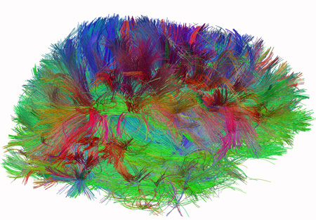
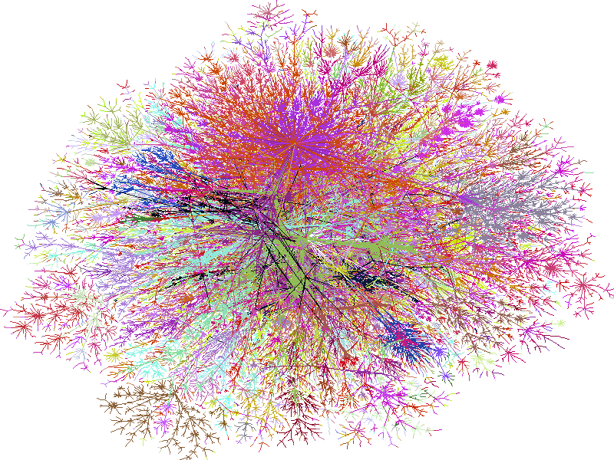
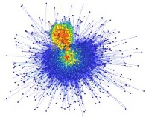





Big real-life graphs
100M(10⁸)
social scale
100B (10¹¹)
Web scale
1T (10¹²)
brain scale, 100T (10¹⁴)
Human Connectome,
(The Human Connectome Project, NIH)
Real-life scope
US
road
Internet
(Opte project)
knowledge
graph
Social graph
(300PB user data)
Web graph
(Google)
BTC
Semantic Web
An NSA Big Graph experiment,
P.Burkhardt, et al, US. National Security Agency, May 2013

Slide 3
Querying big graphs
Given a query Q and a data graph G, find answers Q(G)
Graph pattern matching: knowledge discovery, social recommendation, drug designing…
Reachability: cyber security, metabolic analysis, software engineering, Internet of things…
Challenges
Graphs are too big
Hard to reduce computation complexity
Limited resource
State-of-the-art
Tractable approaches
SSD linear scan for node search: 1PB->1.9 days, 1EB->5.28 yrs
Indexing & Compression
Can we still answer Q with limited resource?

Slide 4
Outline
Resource bounded query answering
Localized: Graph Pattern Queries
Resource bounded simulation queries
Resource bounded subgraph isomorphism
Non-localized: Reachability
Resource bounded reachability
Experimental study
Conclusion & Future work

Slide 5








Queries and data graph
Localized queries: can be answered locally
Graph pattern queries: simulation queries (personalized social search, ego network analysis…)
matching relation over d_{Q}-neighborhood of a personalized node
Non-localized queries
Reachability queries
Michael: “find cycling fans who know both my friends in cycling club and my friends in hiking groups” (IBM Watson, Facebook Graph Search, Apple Siri, Wolfram Alpha Search…)
Michael
cl₅
Michael
(unique match)
…
cl₉
cycling club
member
Michael
(Personalized node)
hiking group
cc₁
…
…
hg₁
cl₄
cl₆
cl₇
…
cl₃
…
cl₁₆
hiking
group
cycling club
member
cc₃
hg₂
cl_{n-1}
cc₁
cc₂
hg_{m}
…
?cycling lovers
cl₁
Eric
cl_{n}
cl₂
cl_{n-1}
Can we still answer Q with limited resource?
cycling fans

Slide 6

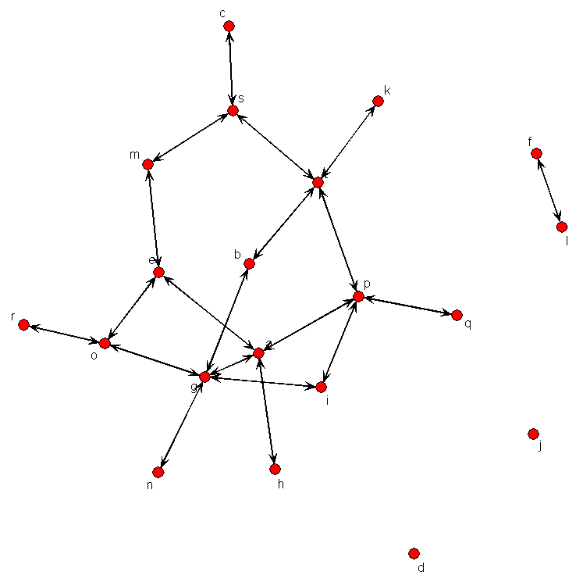
Making big graph “small”
Idea: using a small graph instead of G to make it feasible to answer expensive queries in big graphs.
query
exact
results
big graph
expensive!
Reduction
(bounded resources:
time, space, energy…)
Approximation
(guaranteed quality:
accuracy, error rate, …)
query
approximate
results
small graph

Slide 7
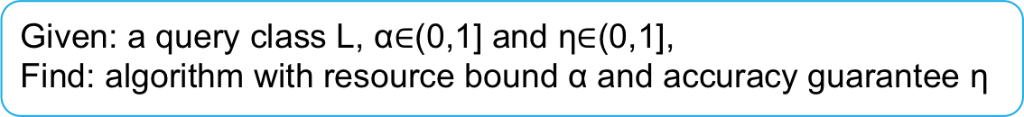
Resource-bounded query answering
Resource-bounded algorithm A for query class L and any G:
with resource bound α
has accuracy guarantee η
query
big graph G
results
expensive!
online reduction
size |G_{Q}| <= α|G|
visit α*c|G| amount of data
(α*c < 1 )
Approximation
Accuracy >= η
query
results
small graph G_{Q}
Given: a query class L, α$∈$(0,1] and η$∈$(0,1],
Find: algorithm with resource bound α and accuracy guarantee η
Notes:
Cost alpha|G| is essential to bounding time, space, energy, or I/O cost.
Offline cost
Graph compression; BlinkDB; budgeted search

Slide 8
Hardness results
Exact resource-bounded querying: η = 100%
Intractability
NP-hard for simulation queries (even when Q is a path and G is a DAG)
Reduction from Set Cover
NP-hard for subgraph queries
Impossibility
For any α, there exists NO algorithm for reachability queries with resource-bound α and 100% accuracy bound
Given: a query class L, α$∈$(0,1] and η$∈$(0,1],
Find: algorithm with resource bound α and accuracy guarantee η
Notes:
Interesting to see new complexity classes defined for resource bounded querying
Not all is lost. We may still have resource bounded algorithms with certain performance guarantees

Slide 9


Resource-bounded simulation
Simulation query
big graph G
results
O(|Q||G|+|G|²)
Reduction
size |G_{Q}| <= α|G|
in O(d_{G}|Q||G_{Q}|) time
Approximation
100% for α >=
query
results
small graph G_{Q}
d_{G}: maximum degree of d_{Q}-neighborhood graph of p-node;
d: diameter of Q; l: distinct label size in Q
f: max number of nodes with a same label & neighbor in Q

Slide 10

Resource-bounded simulation: dynamic reduction
Preprocessing
(auxiliary information)
dynamic reduction
(compute reduced subgraph)
Approximate query evaluation over reduced subgraph
local auxiliary information
u
v
degree | |neighbor| | <label, frequency> | …
Dynamically updated auxiliary information
u
v
？
Boolean guarded condition: label matching
Cost function c(u,v)
Potential function p(u,v), estimated probability that v matches u
bound b, determines an upper bound of the number of nodes to be visited
u
v
Q
G
label
match
Notes:
Auxiliary structure

Slide 11









Resource-bounded simulation: dynamic reduction
preprocessing
dynamic reduction
(compute reduced subgraph)
Approximate query evaluation over reduced subgraph
bound = 14
Match relation:
(Michael, Michael),
(hiking group, hg_{m}), (cycling club, cc₁),
(cycling club, cc₃),
(cycling lover, cl_{n-1}),
(cycling lover, cl_{n})
visited = 16
TRUE
Cost=1
Potential=3
Bound =2
TRUE
Cost=1
Potential=2
Bound =2
Michael
cycling club
member
cycling club
member
hiking group
hiking group
Michael
hg₁
hg₂
hg_{m}
cc₃
hiking
group
cycling club
hg_{m}
cc₃
hiking
group
cycling club
cc₂
cc₁
cc₂
cc₁
FALSE
-
-
-
cl₁
cl₂
…
cl_{n-1}
cl_{n}
?cycling lovers
cl_{n}
?cycling lovers
cl_{n-1}
cycling fans
cycling fans
Notes:
Auxiliary structure

Slide 12

Resource-bounded reachability
Reachability query
big graph G
results
O(|G|)
Reduction
size |G_{Q}| <= α|G|
Approximation
(experimentally
Verified; no false positive,
in time O(α|G|)
Reachability query
results
small tree index G_{Q}

Slide 13

Preprocessing: landmarks
Preprocessing
dynamic reduction
(compute landmark index)
Approximate query evaluation over landmark index
Michael
Landmarks
a landmark node covers certain number of node pairs
Reachability of the pairs it covers can be computed by landmark labels
cl₅
…
cl₉
cc₁
…
cl₄
cl₆
cl₇
cl₃
…
cl₁₆
cl_{n-1}
cc₁ “I can reach cl3”
cl₄
cl₆
cl₃
…
cl₁₆
Eric
cl_{n-1, “cl3 can reach me”}
Notes:
Big picture

Slide 14
Hierarchical landmark Index
Landmark Index
landmark nodes are selected to encode pairwise reachability
Hierarchical indexing: apply multiple rounds of landmark selection to construct a tree of landmarks
Boolean guarded condition (v, source, dst)
Cost function c(v): size of unvisited landmarks in the subtree rooted at v
Potential P(v), total cover size of unvisited landmarks as the children of v
Michael
cl₅
cl₄
…
cl₉
cc₁
cl₃
cl₅
cl₆
…
cl₄
cl₆
cl₇
cl₃
cl₁₆
cc₁
cl₇
cl_{n-1}
cl₉
…
cl₁₆
…
…
cl_{n-1}
Cover size
Landmark labels/encoding
Topological rank/range
Eric
Notes:
Big picture

Slide 15
Resource-bounded reachability
Preprocessing
dynamic reduction
(compute landmark index)
Approximate query evaluation over landmark index
bi-directed guided traversal
Condition = ?
Cost=9
Potential = 46
Condition = TRUE
…
…
Michael
cl₅
cl₄
Condition = ?
Cost=2
Potential = 9
…
cl₉
“drill down”?
cc₁
“roll up”
cl₃
cl₅
cl₆
…
cl₄
cl₆
cl₇
cl₃
cl₁₆
cc₁
cl₇
cl_{n-1}
cl₉
…
cl₁₆
…
…
cl_{n-1}
local auxiliary
information
Michael
Condition = FALSE
-
-
Eric
Eric
Notes:
algorithm

Slide 16
Experimental Study
Dataset
Youtube(1.61 million nodes, 4.51 million edges)
(http://netsg.cs.sfu.ca/youtubedata)
Yahoo Web graph (3 million nodes, 14.98 million edges)
(http://webscope.sandbox.yahoo.com/catalog.php?datatype=g)
Algorithms
Graph pattern matching:
Resource bounded simulation algorithm RBSim
Optimized strong simulation pattern matching MatchOpt
Resource bounded subgraph isomorphism RBSub
Optimized VF2
Reachability:
Resource bounded reachability RBReach
BFS and optimized BFS over compressed graphs
LM: applying landmark vectors (4*Log|V| landmarks)
Notes:
Orders of magnitude times faster if we didn’t optimize the algorithms
240, 135, and 62.5 times faster

Slide 17
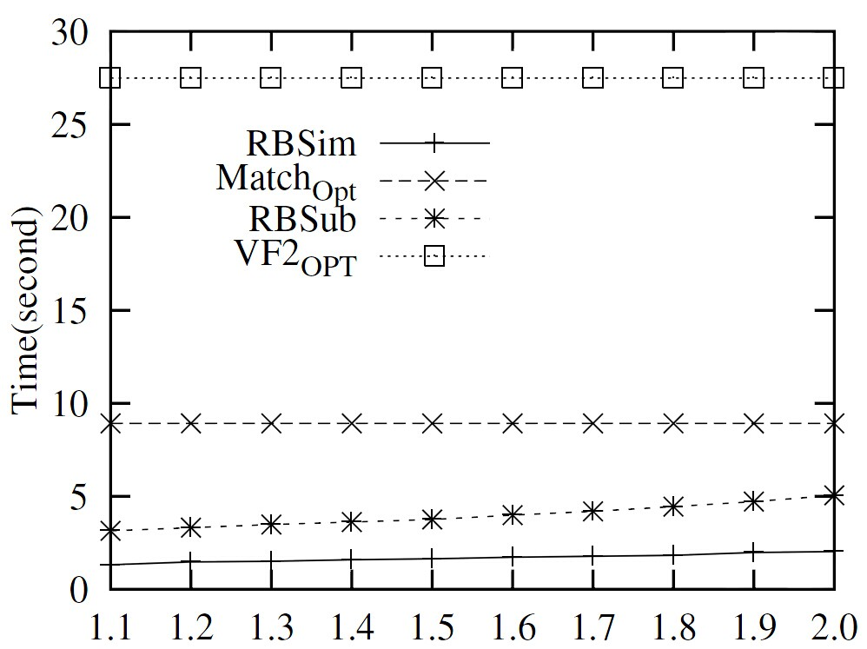
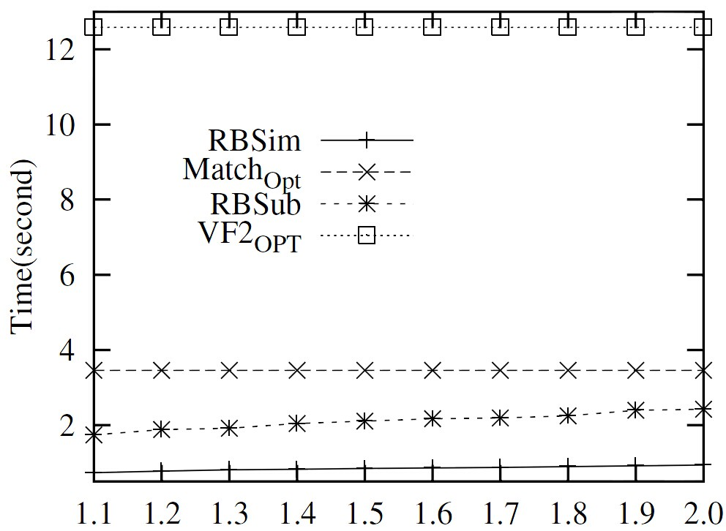
Efficiency of resource bounded simulation
Rbsim is 5.5 times faster than Match-OPT; RBSub is 6.25 times faster than VF2-OPT on average
Varying α ( 10 ⁻⁵), Yahoo
Varying α ( 10 ⁻⁵), Youtube
Notes:
3% of theoretical bounds; 20% of d_Q-neighborhood graph

Slide 18
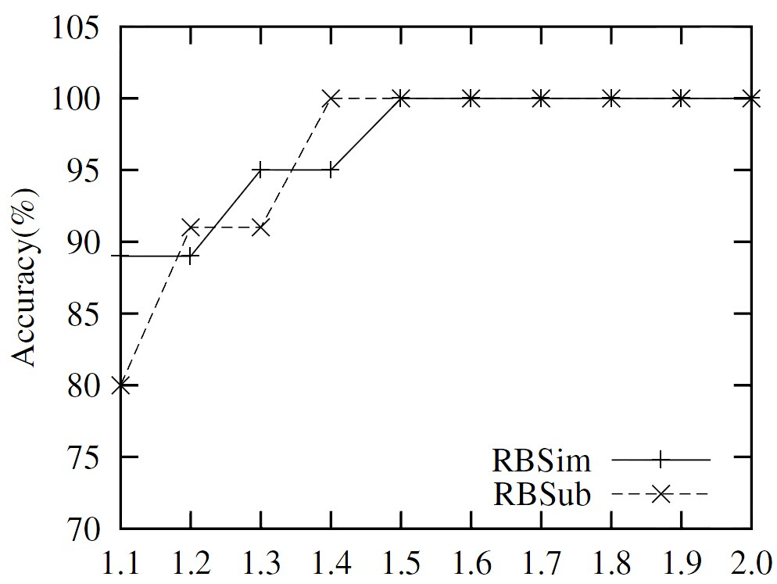
Accuracy
89%-100% for simulation queries
both achieves 100% accuracy when α>0.0015%,
Varying α ( 10 ⁻⁵), accuracy, Yahoo
Notes:
algorithm

Slide 19
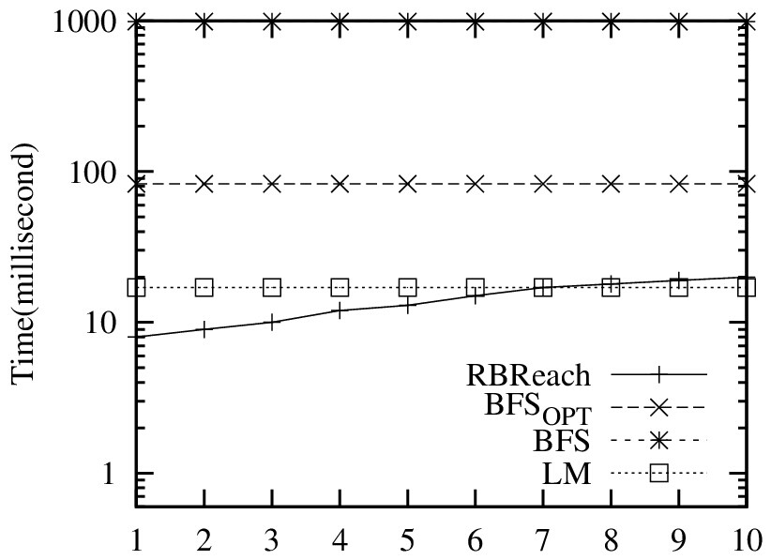
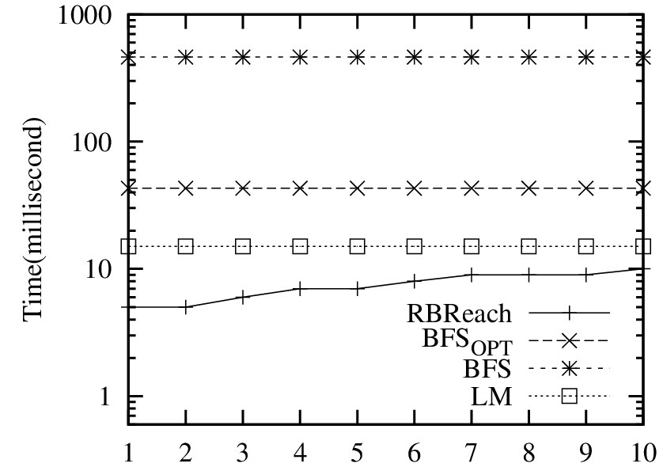
Efficiency of resource bounded reachability
RBreach is 62.5 times faster than BFS
and 5.7 times faster than BFS-OPT
Varying α ( 10 ⁻⁴), Yahoo
Varying α ( 10 ⁻⁴), Youtube
Notes:
algorithm

Slide 20
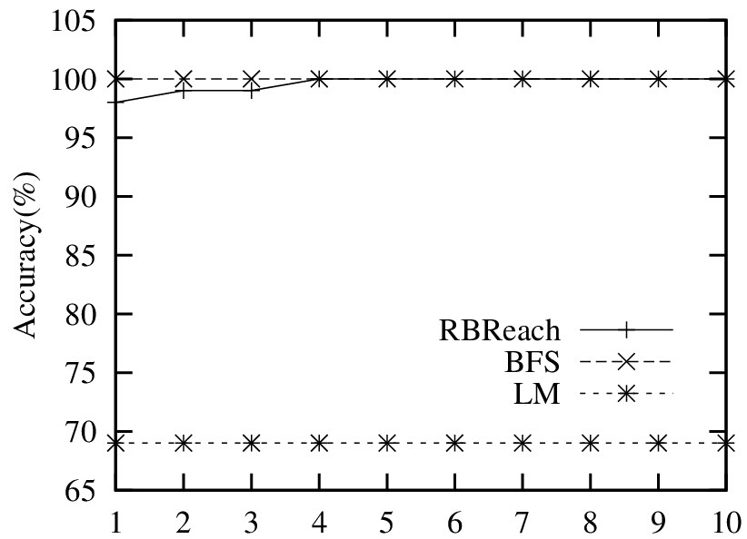
Accuracy
>=96%
achieves 100% accuracy when α>0.05%,
Varying α ( 10 ⁻⁴), accuracy, Yahoo
Notes:
algorithm

Slide 21
Conclusion
Resource bounded querying for big graph processing
Dynamic reduction + approximate query answering
Local queries: strong simulation, subgraph isomorphism
Non-local queries: reachability
tunable performance, a balance of resource and answer quality
More to be done…
Maximum accuracy ratio η resource bounded algorithms can guarantee?
Graph query patterns without personalized nodes, more graph query classes…
Distributed deployment (MapReduce, GraphLab)
Deployment in emerging applications (knowledge graph, cyber network security, medical networks…)
query
big graph
results
expensive!
Reduction
(bounded resources:
time, space, energy…)
Approximation
(guaranteed quality:
accuracy, error rate, …)
small graph
query
results
Notes:
Rich semantics from specified application domain

Slide 22
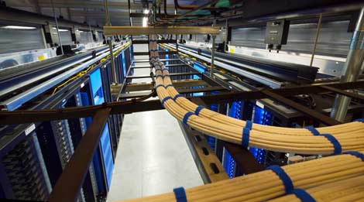
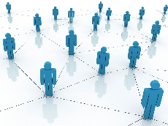
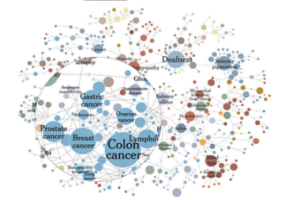
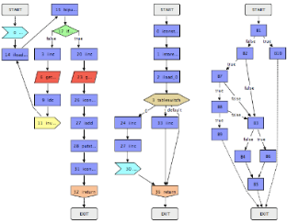
Our journey of scalability & usability
Application
Data center & cyber security
(ICDE 2014， KDD 2014)
Social informatics
(ICDM 2013)
Knowledge Graph
(VLDB 2014,
SIGMOD 2014 demo )
Software engineering
(ongoing)
Dynamic & distributed querying
Incremental
graph matching
(SIGMOD 11)
Graph querying
using views
(ICDE 14,
best paper runner-up)
Distributed graph querying (VLDB 12, 14)
Computational efficient
query models
(VLDB 10,
ICDE 11,
VLDB 13)
Querying big graphs within
bounded resource
(SIGMOD 14)
More…
making big graphs small
Making querying
approximable
Query preserving graph compression (SIGMOD 12)
making big graphs small
Notes:
My recent work addresses this challenge. First, we use graph summarization techniques to help users to understand results and refine their search;
Second, for queries with no exact answers, we use external knowledge such as ontologies to locate more approximate answers.
We also use machine learning techniques to obtain ranking metrics to promote better results.
Finally, we put these together
As a user-friendly graph querying system. Our goal is to balance the usability and unambiguity, and let users to enjoy the advantage of both in search complex graphs.
22

Slide 23
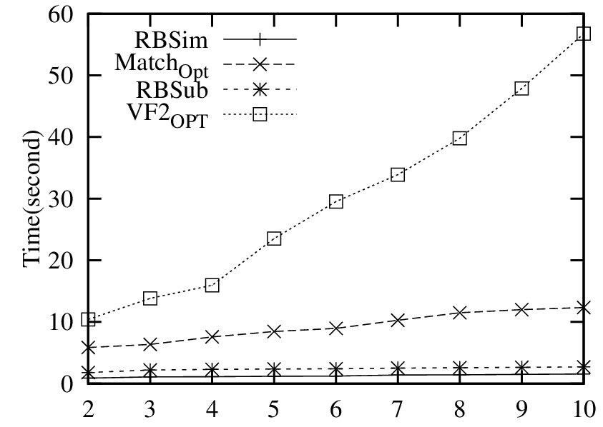
Scalability
Notes:
algorithm

